Slide 1

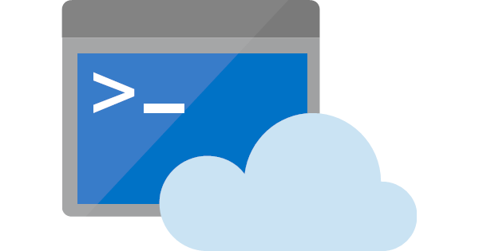
Azure Cloud Shell
An introduction to
Ravikanth Chaganti, Dell EMC
@ravikanth

Slide 2


PowerShell Conference Asia 2019, Bangalore, India
September 19-21
PC: https://www.reliablecarsrental.com/blog/5-short-road-trip-destinations-around-bangalore/

Slide 3
Azure Cloud Shell
Interactive, browser-accessible shell for managing Azure resources.
Supports Bash and PowerShell
Multiple ways to access:
https://shell.azure.com
From the Azure Portal
docs.microsoft.com
VS Code Azure Account Extension
Azure mobile application

Slide 4
Demo
Accessing Cloud Shell

Slide 5
Azure Cloud Shell - Features
Secure automatic authentication
Azure Drive (PowerShell)
Persist across sessions
Multiple tools to manage resources
Integrated Cloud Shell editor

Slide 6
Demo
Demo
Accessing Cloud Shell
Cloud Shell Features

Slide 7
Demo
Questions
Accessing Cloud Shell

